Slide 1

INTRODUCTION TO R PROGRAMMING
MSBA

Slide 2
What is R?
R is a free software environment for statistical computing and graphics. It’s open source and therefore available free of charge.
R is an object-oriented programming language where we create objects and manipulate them as intended. Objects can be Data frames, vectors, matrices, lists, raw data, spatial objects , maps etc..​

Slide 3
Why r?
Statistical Excellence
Open Source and free
Visualization Virtuosity
Cross-Platform Compatibility
Scalability and Integration

Slide 4
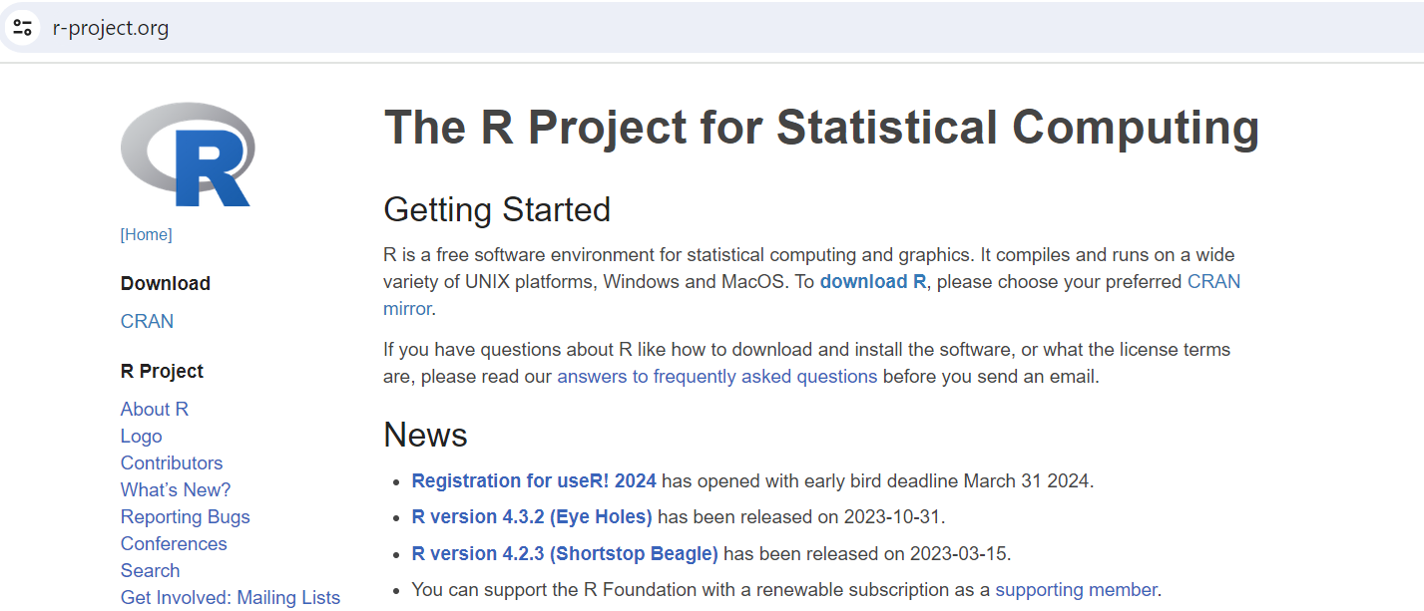
INSTALLATION OF r
https://www.r-project.org/
https://www.r-project.org/

Slide 5
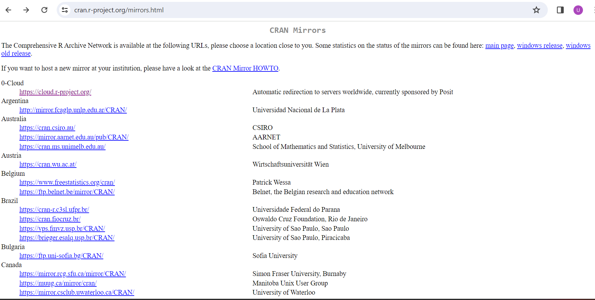
INSTALLATION OF r

Slide 6
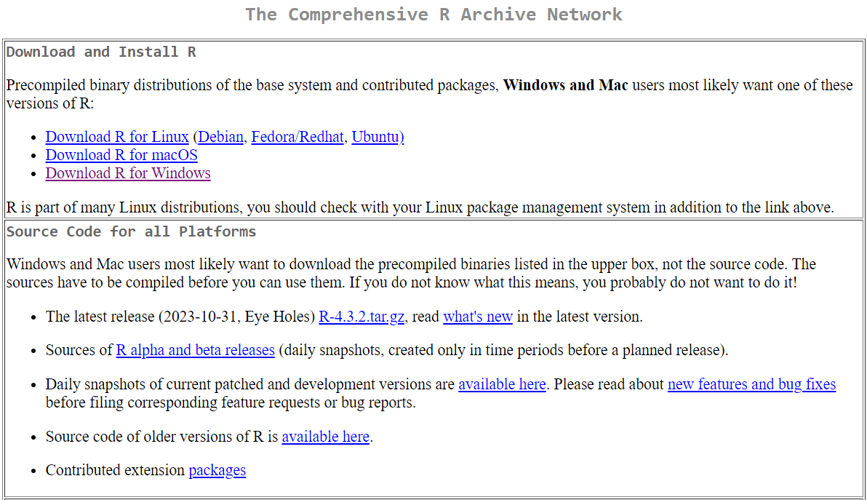
INSTALLATION OF r

Slide 7
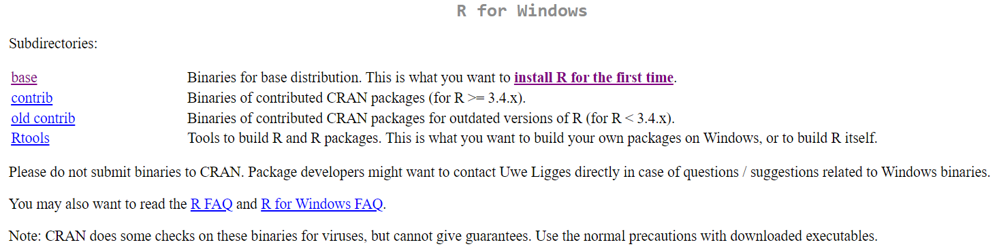
INSTALLATION OF r

Slide 8
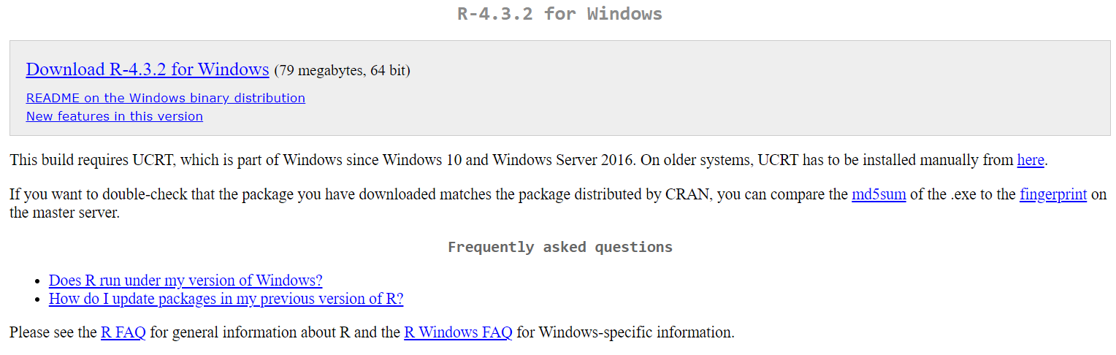
INSTALLATION OF r

Slide 9
R-STUDIO
R studio is a powerful and productive user interface for R. It's free and open source, and works great on Windows, Mac, and Linux.
It is open-source (i.e. free) and available at https://posit.co/download/rstudio-desktop/

Slide 10
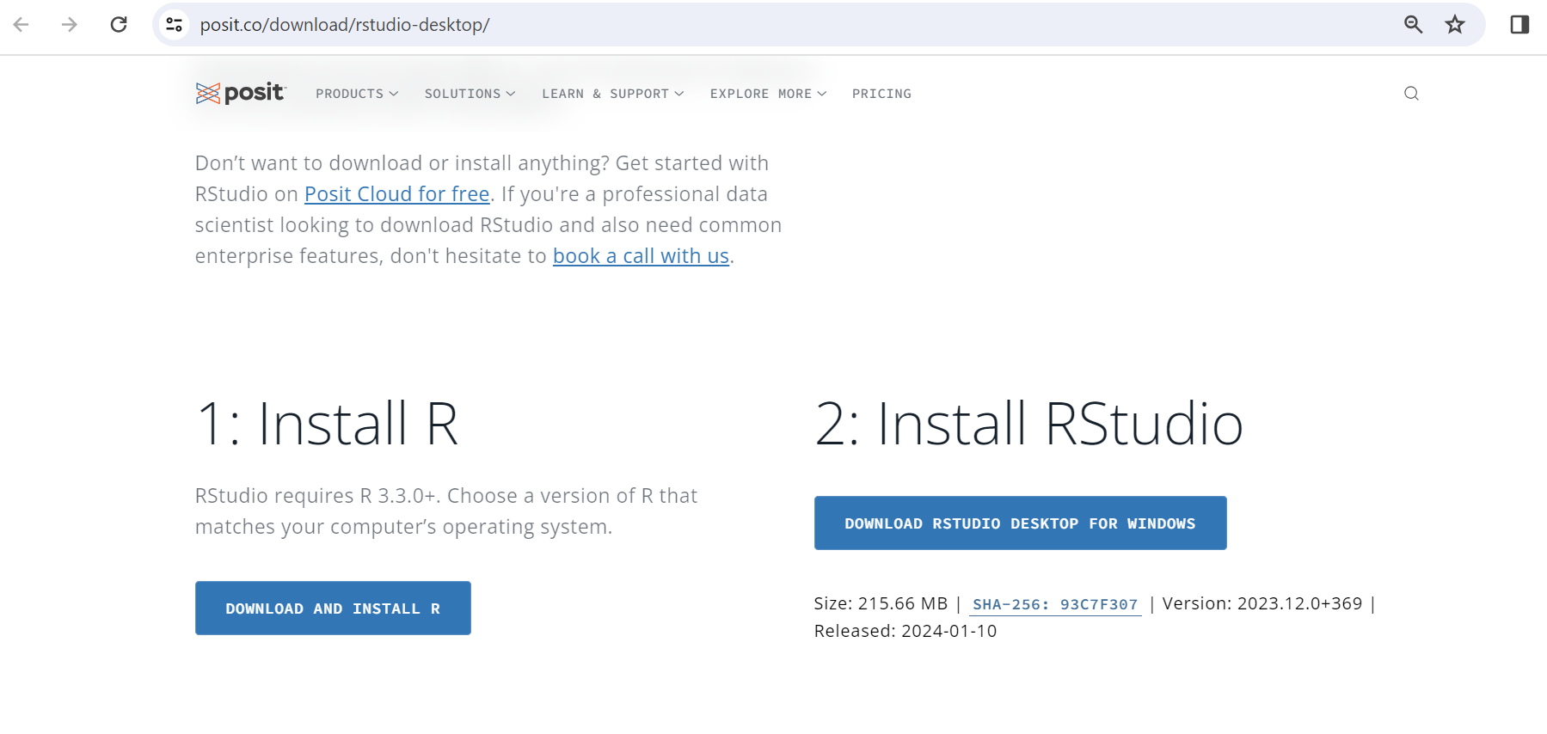
INSTALLATION OF r-Studio

Slide 11
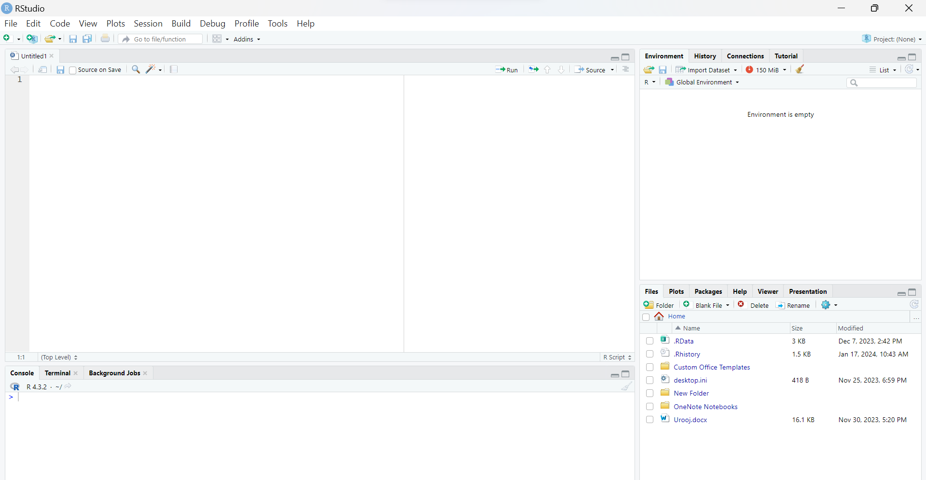
R-STUDIO INTERFACE

Slide 12
R PACKAGEs
An R package is a collection of R functions, compiled code, and sample data bundled together as a unit for distribution and installation in the R environment.
After you install a package, you need to use the function library( ) to load and attach the function before you can use it.

Slide 13
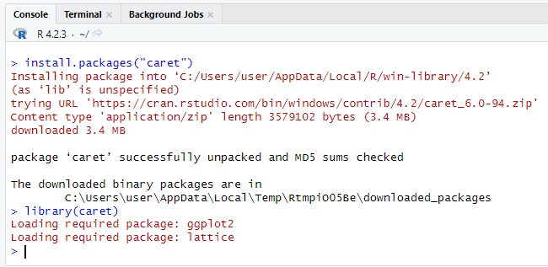
How to Install R package?

Slide 14
